Slide 1
Model Predictive Control Based Jumping of Robotic Leg on a Particular height using Reinforcement Learning (Pros and cons of technology choice and Milestone chart)
Presented by :
Amrita Rai
DBUU
1

Slide 2
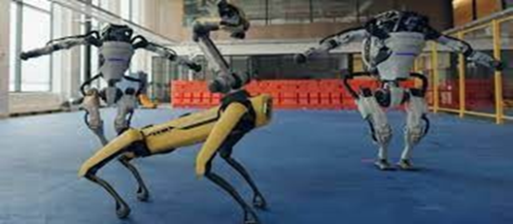
Introduction
Robots are essential to the study of physics because they can perform tasks that humans are unable to.
We are specifically referring to space robots, which have the ability to live in space, transport supplies for space missions, monitor space stations, or just stroll on the earth so that people may view these locations from a distance.
An industrial robot is a versatile manipulator that can be autonomously controlled, reprogrammed, and programmed in three or more axes.
Figure 1: Boston Robots
4

Slide 3
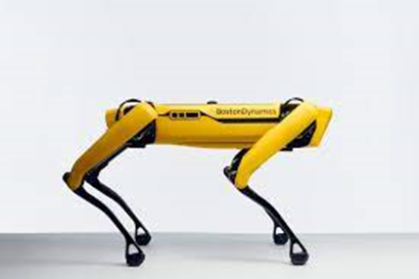
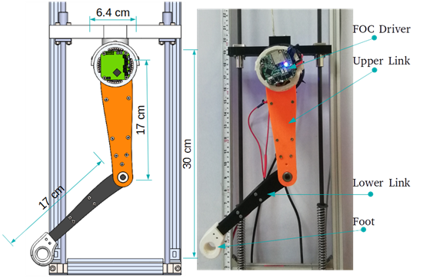
Introduction
Robotics:
Robotics is the science and technology of robots, their design, manufacturing and application.
Robotics develops machines that can substitute for humans and replicate human actions.
Figure 2: Spot Figure 3: Bob(Car)
5
[1] https://robots.ieee.org/robots/minicheetah/
[2] https://www.giantfreakinrobot.com/sci/robot-cheetah.html

Slide 4
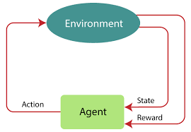
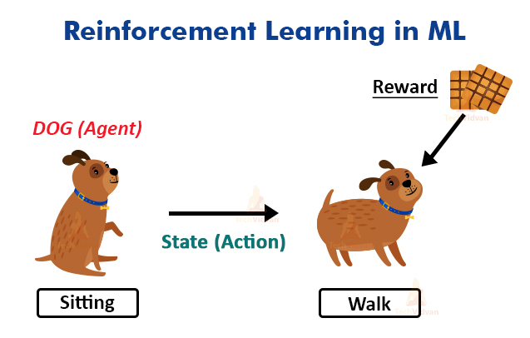
Introduction
Reinforcement Learning : An agent in environment who learn from there action and try to get cumulative rewards.
Figure4: Reinforcement Learning
Figure5: A sitting dog (agent) want to walk ,
for this he will get biscuits as a reward.
6

Slide 5
Stakeholder Identification
Stakeholders:
Project Manager: Oversees project execution.
Robotics Engineers: Design and implement the robotic leg.
Data Scientists: Develop and optimize RL algorithms.
Research Institutions: Provide insights and support.
End Users: Offer feedback for usability.
Investors: Fund the project and monitor outcomes.

Slide 6
Stakeholder Relationships
Relationships:
Project Manager liaises with all stakeholders.
Engineers work closely with Data Scientists for integration.
Research Institutions provide collaborative support.
Feedback from End Users informs design improvements.

Slide 7
Challenges in the Project
Challenges:
Achieving precise jump height.
Real-time computational requirements.
Maintaining stability during operations.
Competitive Advantage
Differentiation from Competitors:
Superior adaptability and precision in control.
Utilization of the latest RL algorithms for optimization.
Customization capabilities for specific user needs.

Slide 8
Key Risks and Solutions
Key Risks:
Technical issues with control algorithms.
Budget overruns.
Timeline delays.
Risk Management Solutions:
Regular progress assessments.
Agile methodology for flexibility.
Contingency budgeting.

Slide 9
Technology Overview
Model Predictive Control (MPC): Predictive control capabilities, computationally intensive.
Reinforcement Learning (RL): Learns from interactions, adaptable but data-intensive.
Traditional Control Systems: Less complex but less adaptable.
Pros and Cons of Technologies
MPC:
Pros: High precision, predictive capabilities.
Cons: High computational demand, complex implementation.

Slide 10
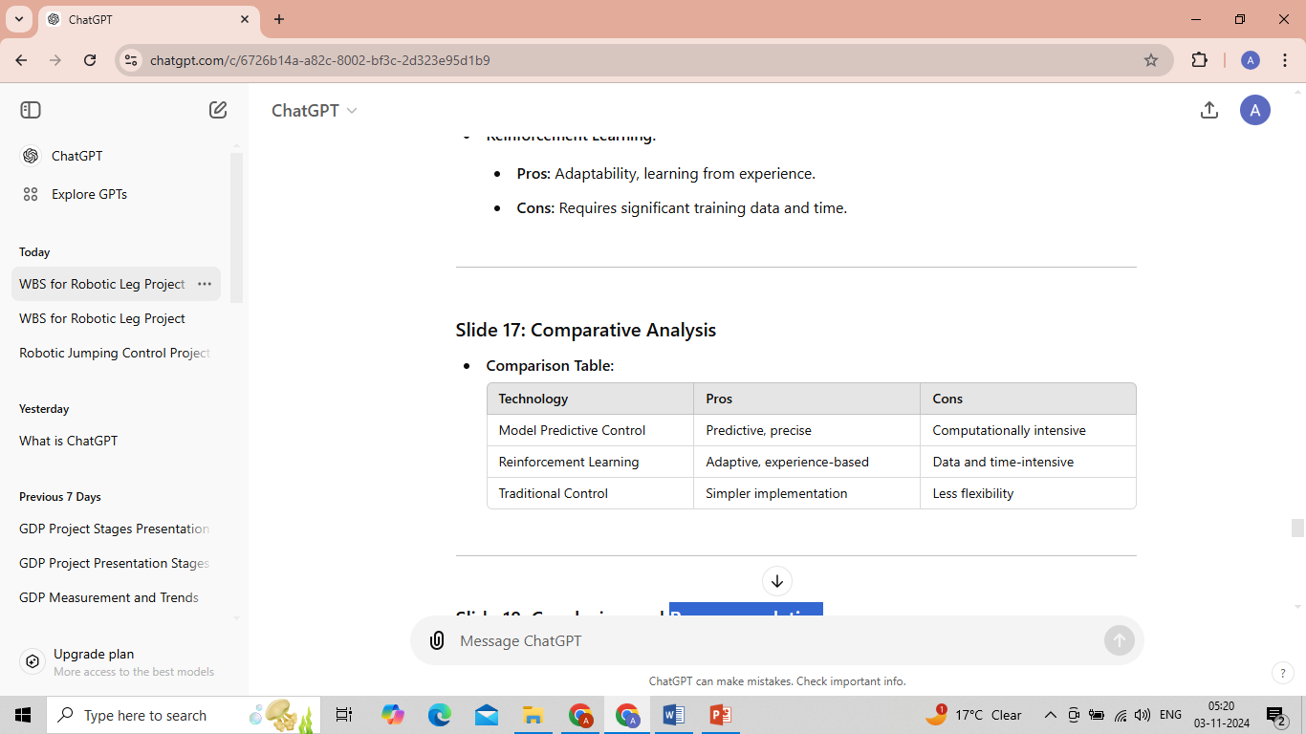
Reinforcement Learning
Pros: Adaptability, learning from experience.
Cons: Requires significant training data and time.
Comparative Analysis

Slide 11
Conclusion and Recommendation of technology choice
Conclusion:
Both MPC and RL have strengths and weaknesses.
A combination may offer the best results, leveraging MPC for precision and RL for adaptability.
Recommendation:
Use MPC for controlling jumps, enhanced with RL for optimization.

Slide 12
Key Project Milestones
Milestone Chart:
Introduce the following milestones with a Gantt chart format:
Project Initiation
Stakeholder Analysis
Requirements Gathering
Design Phase
Prototype Development
Testing and Validation
Deployment Preparation
Project Completion

Slide 13
Milestone Details
1.Project Initiation:
Set project objectives and scope.
2. Stakeholder Analysis:
Identify and engage stakeholders, define roles and relationships.
3. Requirements Gathering:
Collect project requirements from stakeholders.
Continued Milestone Details
4.Design Phase:
Develop system architecture and control algorithms.

Slide 14
5. Prototype Development
Build and test a functional prototype of the robotic leg.
6. Testing and Validation:
Conduct performance tests to validate the control strategies.
Final Milestones
7. Deployment Preparation:
Prepare for deployment and user training.
8. Project Completion:
Finalize project documentation and present results to stakeholders.

Slide 15


